Slide 1


2017 Fall CS548 Project 5
Topic: Text Mining
News Domain Detection Using Classification and Clustering
Yuchen Shen

Slide 2
Dataset Description
Source: Ag’s News in Deep Learning Open Dataset: https://deeplearning4j.org/cn/opendata
AG is a collection of more than 1 million news articles. News articles have been gathered from more than 2000 news sources.
Data Description:
7600 samples from ‘test dataset’ ; each domain has 1900 samples;
news domains from 1 to 4, World, Sports, Business, Sci/Tech

Slide 3
Data Preprocessing
Split
Extract 475 from each domain of news from ‘train dataset’ to construct the new test dataset which contains 1900 news samples.
delete
method
Delete useful columns in csv, such as ‘title’( short description of the news.)
Consider the distribution of this news dataset, some methods like ZeroR is manually exclude.

Slide 4
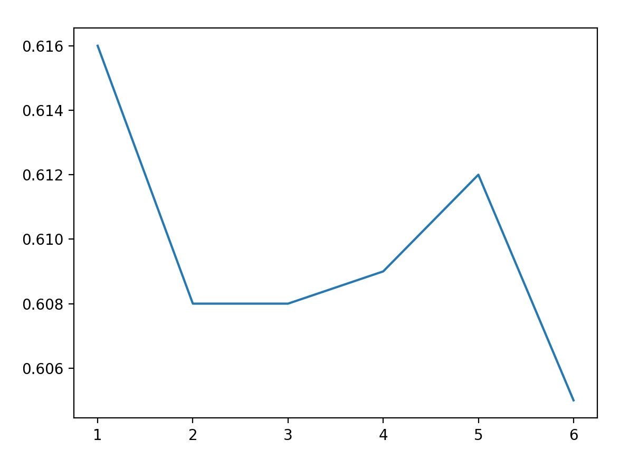
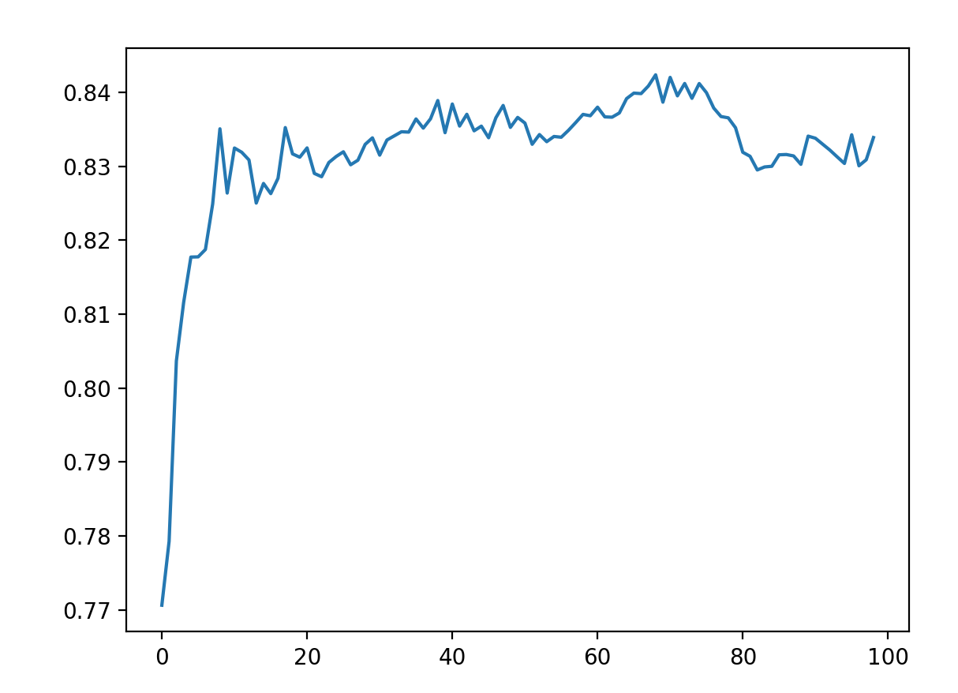

Features: different type of words, phrases.
Knn: test from k=1 to k=100
Increase from 1 to 70
Decease from 75
Single word: 0.616
Single word and (2 to 5 words) phrase: 0.612
K = 62 0.838
Min/Max word appear rate: 0.1%/80%

Slide 5
Guiding Questions
Which news domain will always use domain words?
Which domains using words are most similar with each other?
Which news domain uses widest word domain?

Slide 6
Experiment
For classification, K Nearest Neighbor method with k = 62 gives the best result of precision = 0.838; Decision tree and Random Forest methods all gives a quite good result of precision above 0.60;
For clustering, traditional methods all gives a result below 0.30. Traditional methods not suit with text data. But using manifold visualization can have a quick view of the initial data.

Slide 7
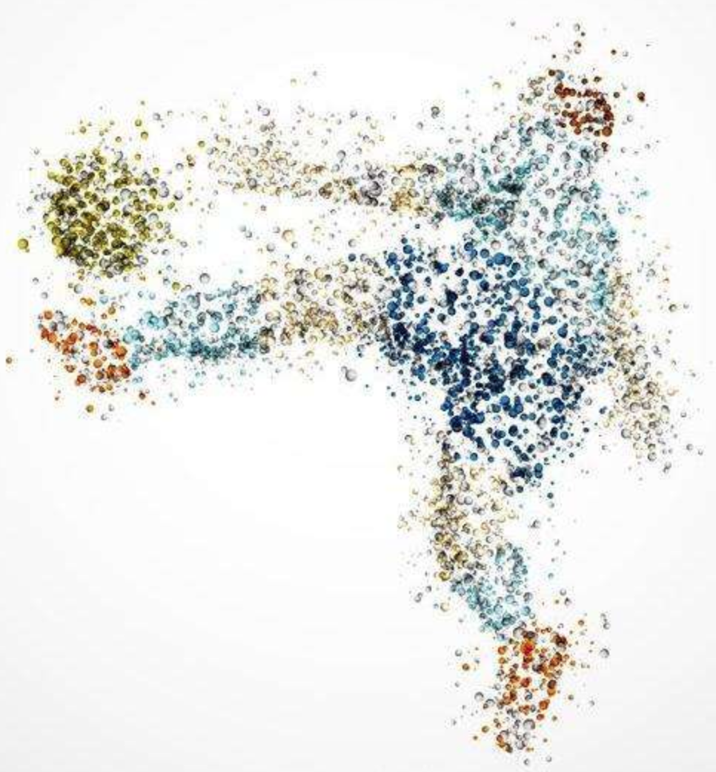
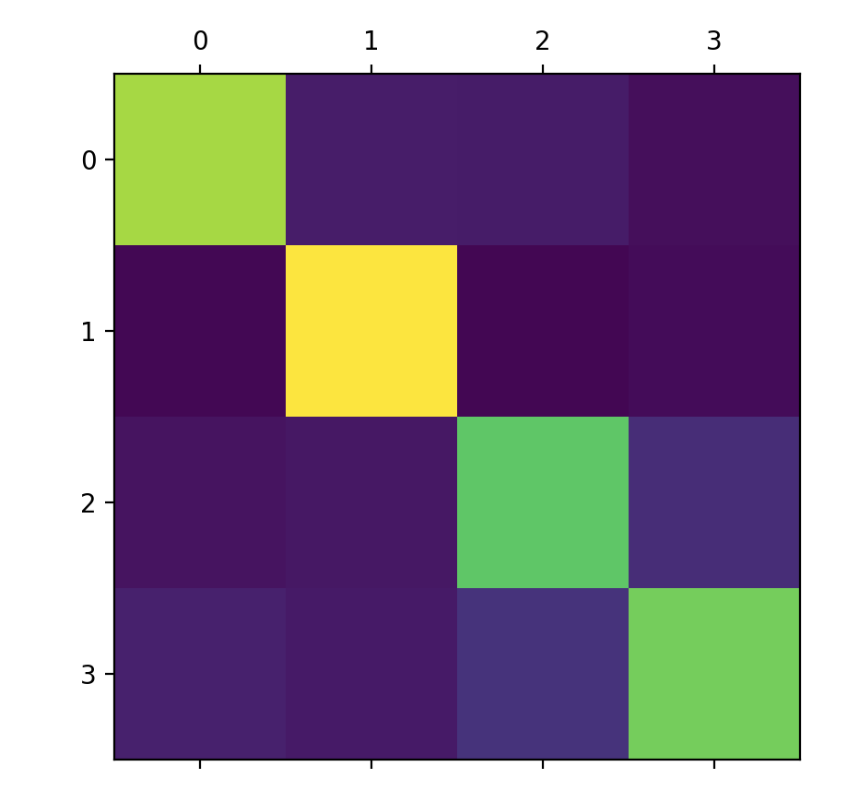


Interesting Results
Sports domain always use special words;
Sports and Club Name
Business news and Sci/Tech news mixed together, they use similar words in news text.
Example:
Yahoo and SBC Communications have agreed to collaborate to extend some of the online services and content they currently provide to PC users to mobile phones and home entertainment devices.

Slide 8
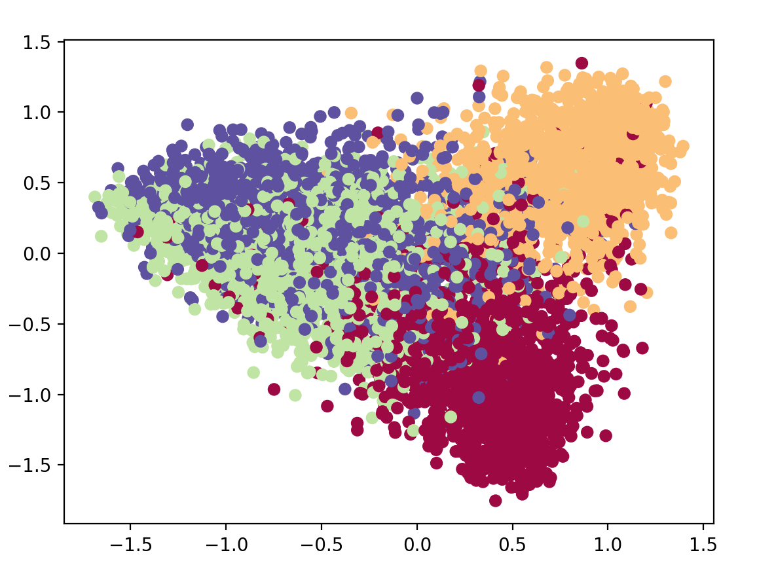
Orange: Sports news stays together;
Red: world news have a quite good performance, but it have many points split in other domains.
Purple and Green: Business news and Sci/Tech news can not be recognized easily.

Slide 9
Reference
[1] Ag’s news Description https://www.di.unipi.it/~gulli/AG_corpus_of_news_articles.html
[2] Kulkarni M, Kulkarni S. Knowledge Discovery in Text Mining using Association Rule Extraction[J]. International Journal of Computer Applications, 2016, 143(12). https://pdfs.semanticscholar.org/3447/cfc544fafd3ef11cdd4260a16cb0d178db4a.pdf
[3] Yiming Yang. (2000). Decision Trees in Text Categorization 15-381
[4] David D.Lewis Ctr.for Info.and Lang.(1994) A Comparison of Two Learning Algorithms forText Categorization

Slide 10
Thanks! Q & A

